Slide 1
What is rural? -- and who should care?
January 2022 Joe Belden belden1419@gmail.com
Notes:
Intros all around
Review 5 days
Disclaimer
Origin of title

Slide 2
And --
“Why should I care?” Well, maybe not.

Slide 3
One reason? Declining Democratic strength in rural areas
Democratic Presidential candidates have become progressively stronger in large and “mega” cities – and progressively weaker in small towns and rural areas. Dems have become the urban party and Repubs the rural party.
Bill Clinton in 1992 and 1996 won over 50% of rural and small-town votes. Hillary Clinton in 2016 won only 30% in rural and 34% in small towns.
Notes:
BUT it has become apparent that Dems are declining in rural.

Slide 4
Presidential Voting Trends, 1998-2016 Source: Sean Trende & David Byler, “How Trump Won - Conclusions,” Real Clear Politics, January 20, 2017.
Notes:
A stark table.

Slide 5
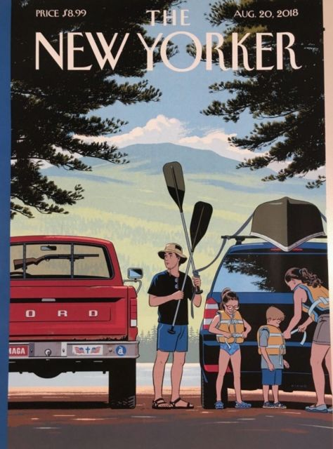

Slide 6
How is rural defined? -- Too many ways
Rural and urban
Nonmetropolitan areas
Metropolitan Statistical Areas – City and suburb – 50,000 +
Micropolitan Statistical Areas – 10,000 – 49,999
Outside core-based statistical areas Huh?
Definitions in federal programs

Slide 7
How much of the population is rural?
From 2010 to 2020 –
The US population grew by 22.7 million to 331.4 million – a 7.4 % increase.
The rural and small-town population grew by only 164,000 – 0.3% -- to 60.6 million.
The US urban population grew by nearly 5 million – a 5.0 % increase.
The suburban-areas population grew by over 17 million people – an 11.8 % increase.

Slide 8
What is rural?
Metro and nonmetro areas (1,167 metro and 1,976 nonmetro counties)
Urban and rural (rural is less than 2,500)
Micropolitan areas (10,000 to 50,000) This is also part of the old nonmetro.
Outside urbanized areas
USDA program definitions
AND – By one measure 54% of the rural population lives in metropolitan areas, in outlying suburban and exurban counties.
DOES YOUR HEAD HURT YET? MINE DOES.
Notes:
Folks like Keith and me often get asked how we define rural.
Turn over to Keith. Note Fed Reserve conference reaction.

Slide 9
“Are you from a rural area?” “Well, I used to be. Now OMB says I’m from an outside-core-based statistical area.”
OMB has defined 927 core-based statistical areas (CBSAs) for the United States and 12 for Puerto Rico. A core-based statistical has one or more adjacent counties or county equivalents that have at least one urban core area of at least 10,000 population, plus adjacent territory that has a high degree of social and economic integration with the core as measured by commuting ties.
The 939 Core Based Statistical Areas currently include 392 Metropolitan Statistical Areas (MSAs), which have an urban core population of at least 50,000, and 547 Micropolitan Statistical Areas, which have an urban core population of at least 10,000 but less than 50,000. 543 are in the continental US and 4 are in Puerto Rico.
The rest – less than 10,000 – are now classified as Outside Core-based Statistical Areas.

Slide 10
Micropolitan Areas
The US has 543 Micropolitan Statistical Areas, ranging in size from just over 12,000 to more than 221,000. 29 are over 100,000 in population; 211 are over 50,000; and 332 are under 50,000. 5 of the 7 smallest are in Texas.
Between 2010 and 2020 –
-- 42 of the largest 100 micros and 8 of the top 25 lost population.
-- 70 of the smallest 100 and 16 of the smallest 25 lost population.

Slide 11
Where are the micro areas?
Wyoming had the highest share of any state population living in micros — 44.2% ­­— while Delaware, New Jersey and Rhode Island had zero micros.

Slide 12
Metropolitan Areas
The US has 392 Metropolitan Statistical Areas, up from 383 in 2010. Largest are –
Millions
NY-Newark-Jersey City (NY, NJ, CT) 20.1
LA-Long Beach-Anaheim (CA) 13.2
Chicago-Naperville-Elgin (IL, IN) 9.6
Dallas-Ft Worth-Arlington (TX) 7.6
Houston-Woodlands-Sugarland (TX) 7.1
Washington-Arl.-Alex. (DC, MD, VA, WV) 6.4

Slide 13
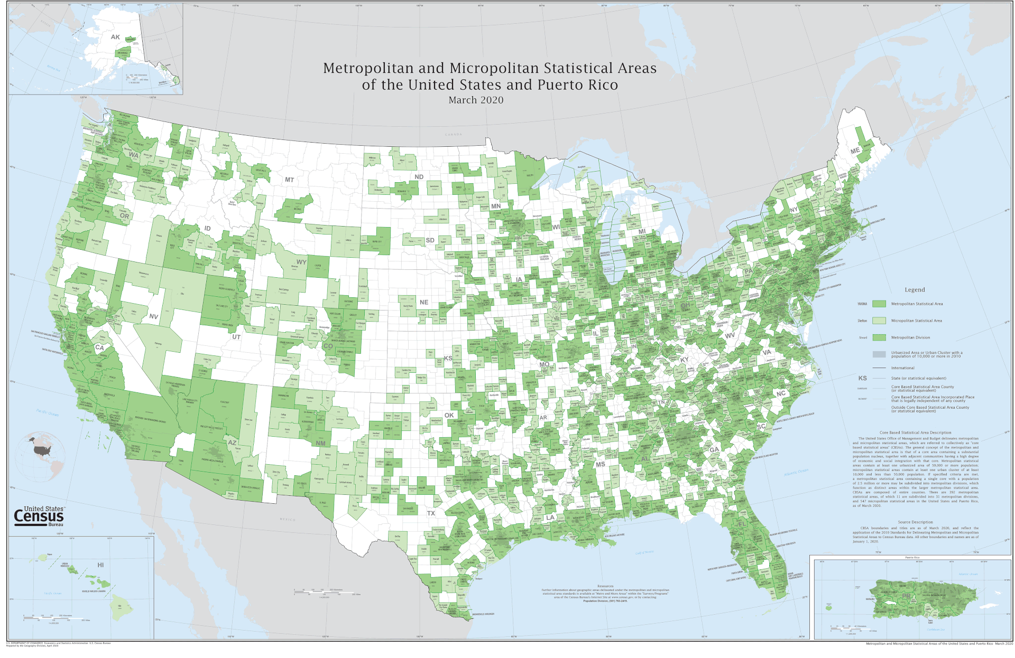

Slide 15
Largest micros --
2020 Percent change population from 2010
Lebanon NH-VT 221,211 + 1.26 Hilo, HI 200,629 + 8.4 Torrington, CT 185,186 - 2.5 Tupelo, MS 163,398 + 1.15 Concord, NH 153,808 + 5.03

Slide 16
Smallest micros --
2020 Percent change population from 2010
Ketchikan, AK 13,948 + 3.49 Zapata, TX 13,889 - 0.92 Craig, CO 13,292 - 3.65 Vernon, TX 12,887 - 4.79 Lamesa, TX 12,454 - 9.95

Slide 17
A question --
What are the most rural states? ???
-- Percentage rural is very different from population.

Slide 18
A rural factor --
PA has 3rd largest rural population in US, with 2.40 million people. MI and WI are not far behind, with 1.92 million and 1.86 million.

Slide 19
The Farm Bill -- every five years
2018 bill is projected to cost $428 billion over 2019-2023 –
$326 billion to nutrition programs such as SNAP
$39 billion to crop insurance
$30 billion to commodity programs
$30 billion to conservation programs
$4 billion to everything else

Slide 20
The Farm Bill – cont. 12 titles --
Title 1: Commodities. Title covers price and income support for the farmers who raise widely-produced and traded non-perishable crops, like corn, soybeans, wheat, and rice – as well as dairy and sugar. Also includes agricultural disaster assistance.
Title 2: Conservation. Covers programs that help farmers implement natural resource conservation efforts on working lands like pasture and cropland as well as land retirement and easement programs.
Title 3: Trade. The Trade title covers food export subsidy programs and international food aid programs.
Title 4: Nutrition. Covers the Supplemental Nutrition Assistance Program [SNAP] (formerly known as food stamps) and a variety of smaller nutrition programs to help low-income Americans afford food for their families.
Title 5: Credit. The Credit title covers federal loan programs designed to help farmers access the financial credit (via direct loans as well as loan guarantees and other tools) they need to grow and sustain their farming operations. , and veteran farmers and ranchers, agricultural labor safety and workforce development, and livestock health.

Slide 21
Farm Bill – cont.
Title 6: Rural Development. The Rural Development title covers programs that help foster rural economic growth through rural business and community development (including farm businesses) as well as rural housing, and infrastructure. Title 7: Research, Extension, and Related Matters. The Research title covers farm and food research, education, and extension programs designed to support innovation, from federal labs and state university-affiliated research to vital training for the next generation of farmers and ranchers. Title 8: Forestry. The Forestry title covers forest-specific conservation programs that help farmers and rural communities to be stewards of forest resources. Title 9: Energy. The Energy title covers programs that encourage growing and processing crops for biofuel, help farmers, ranchers and business owners install renewable energy systems, and support research related to energy.

Slide 22
Farm bill – cont.
Title 10: Horticulture. The Horticulture title covers farmers market and local food programs, funding for research and infrastructure for fruits, vegetables and other horticultural crops, and organic farming and certification programs. Title 11: Crop Insurance. The Crop Insurance title provides premium subsidies to farmers and subsidies to the private crop insurance companies who provide federal crop insurance to farmers to protect against losses in yield, crop revenue, or whole farm revenue. The title also provides USDA’s Risk Management Agency (RMA) with the authority to research, develop, and modify insurance policies. Title 12: Miscellaneous. The Miscellaneous title is a bit of a catch-all. The current title brings together six advocacy and outreach areas, including beginning, socially disadvantaged

Slide 23
What is USDA -- ?
We provide leadership on food, agriculture, natural resources, rural development, nutrition, and related issues based on public policy, the best available science, and effective management.
We have a vision to provide economic opportunity through innovation, helping rural America to thrive; to promote agriculture production that better nourishes Americans while also helping feed others throughout the world; and to preserve our Nation's natural resources through conservation, restored forests, improved watersheds, and healthy private working lands.
The U.S. Department of Agriculture (USDA) is made up of 29 agencies and offices with nearly 100,000 employees who serve the American people at more than 4,500 locations across the country and abroad.

Slide 24
USDA mission areas -- each with subagencies
Farm production and conservation
Food, nutrition and consumer services
Food safety
Marketing and regulatory programs
Natural resources and environment
Research, education and economics
Rural development
Trade and foreign agricultural affairs (e.g., FAS)

Slide 25
Greg Sparks et al., COVID-19 Vaccine Monitor: Differences in Vaccine Attitudes Between Rural, Suburban, and Urban Areas, KFF, 22 Dec. 2021 https://www.kff.org/coronavirus-covid-19/poll-finding/kff-covid-19-vaccine-monitor-vaccine-attitudes-rural-suburban-urban/
Definitely won’t get vac. Already gotten vac.
Rural 21 % 67 % Suburban 16 70 Urban 8 79
Vac., already got booster Vac., definitely get booster Total Rural 14 29 43 Suburban 14 23 37 Urban 18 25 43

Slide 26
Trump won rural voters. Clinton won urban.
PERCENT OF VOTE RURAL SUBURBAN URBAN
Trump 62 50 35
Clinton 34 45 59
Source: Rich Morin, “Behind Trump’s win in rural white America: Women joined men in backing him,” Pew Research Center, 17 Nov. 2016
BUT NOTE: Some suburban and exurban areas are rural. “Rural” has too many definitions -- metro/nonmetro counties, micropolitan small cities, rural/urban, federal programs, etc.
Notes:
See how the rural vs urban shares were almost the exact reverse between T and Clinton.

Slide 27
Trump won white voters, men and women
WHITE WHITE ALL
PERCENT OF VOTE RURAL ALL VOTERS
Trump -- Women 62 53 43
Men 72 63 53
Clinton -- Women 34 43 54
Men 24 31 42

Slide 28
West Virginia – an example
One of only 2 states with Trump winning in all counties.
Used to be a mostly Democratic state. In 13 Presidential elections in WV from 1932 through1996, the Democrat won 10. The Republican won 3 times in 2nd term landslides – 1956, 1972, and 1984. Even Dukakis in 1988 and Humphrey in 1968 won the state.
But then in 2000 and thereafter, the Republican presidential candidate won with increasing margins. Trump’s total was almost 70%.
HUH? WHAT HAS HAPPENED?
Notes:
Introduce John Frisk.

Slide 29
November 2018 results
Statewide Democratic candidates in red or purple states won if they got 40% or more of the rural vote. E.g., Dem governors in KS and WI got 52% and 41% of the rural vote – and won. Losing Dem gubernatorial candidates in FL and GA got 15% and 28% of the rural vote.

Slide 30
One indicator of being left behind and pissed off
Philanthropic grant making Per capita grant making 2010-2014
Mississippi Delta & AL Black Belt $ 41
Coal & Low Country $ 43
Rio Grande Valley $ 92
United States $ 451
New York State $ 995
New York City $ 1,966
San Francisco $ 4,066
Source: National Comm. for Responsive Philanthropy & Grantmakers for Southern Progress, As the South Grows, April 2017

Slide 31
Military service and sacrifice gap is wide
Since 2003 US military combat deaths have been 18.6 per million population in metro areas, but 28.2 per million in micropolitan small cities, & 27.7 per million people in rural areas.
-- Bill Bishop, “Soldiers’ Death Rates Reveal Two Americas,” Daily Yonder
Military recruits are more likely to come from and return to rural areas and small towns. The reserves, Guard, & veterans’ organizations are more part of small-town life.
Veterans are 11% of the rural, 9% of the suburban, & 7% of the urban population.

Slide 32
Elites of left and right
One theory is that Democrats have become the cultural elite and Republicans have become the business and economic elite. (E.g., Clintons/Hollywood/media and Bushes/Romneys/Wall Street/etc.)
Working- and middle-class folks – especially whites with less than a college education – are disgusted with both these elites. Trump steps in as the champion of the disaffected.

Slide 33
News deserts
171 US counties have no local newspaper. 1,449 have only one, mostly a local weekly. 1/5 of US newspapers have closed since 2004, with close to 1/3 of those in rural areas.
-- Daily Yonder, 22 October 2018

Slide 34
William Frey, New Census Results Show Increased Diversity Countering Decade-Long Declines in America’s White & Youth Population, Brookings Institution, 13 August 2021

Slide 35
What was the post-Nov. 3 attempt to overturn the result in certain states?
Percent Percent Population Black Hispanic
Atlanta -- 506,000 51 5
Detroit -- 670,000 83 7
Milwaukee -- 590,000 40 17
Philadelphia -- 1,584,000 43 14
Phoenix -- 1,681,000 7 41
Pittsburgh -- 306,000 26 2

Slide 36
Red everywhere ??
Some rural areas in many places – those with large populations of people of color – voted and have almost always voted Democratic.
The media’s and politicians’ cliché that rural areas are a sea of red is not true.
Map on next slide shows blue Dem-voting and red Republican-voting counties. Many of the blue counties are in rural places with large minority populations.
17 counties in US voted 80% or higher for Clinton – DC, NYC -- and rest are rural Black and Native American counties in SD, MS, AL and GA.
Notes:
Rural US is NOT all red voting.

Slide 37
2016 election results by county

Slide 38
TV and film today
Why does Hollywood seem to think rural America is either ridiculous or evil? In the 1960s and early 1970s, television shows like The Beverly Hillbillies; Gomer Pyle, USMC; and Green Acres portrayed rural places and people as comic, slapstick, and often frankly ridiculous.
The Waltons and Little House on the Prairie later were sympathetic. Dating from the 1930s and 40s, very popular comic strips like Lil’ Abner and Pogo satirized rural locales and characters but also had social and political comment.

Slide 39
More meaner turn
But today small towns on TV and in film – with the exception of the Hallmark Channel -- seem to be scary places of crime and danger. Examples include Ozark, Sharp Objects, Rectify, Three Billboards, and No Country for Old Men. And of course Deliverance from a few years earlier.

Slide 40
The hillbilly Clampetts arriving in Beverly Hills -- from show’s opening credits. Condescending but at least not murderous.

Slide 41
One view --
The 2016 election “was fundamentally about … who is America – and American. It was a debate about whether … Barack Obama was an American … [And] about:
--how many immigrants to admit to the country …
--how much of a threat was posed by Muslims [in] the United States …

Slide 42
Sides et al. continued
--whether innocent blacks were being systematically victimized by police forces [and]
--whether white Americans were being unfairly left behind in an increasingly diverse country.”
-- John Sides et al., Identity Crisis: The 2016 Campaign and the Battle for the Meaning of America (Princeton, NJ: Princeton University Press, 2018)

Slide 43
Status threat or economic hardship?
Growing domestic racial diversity and a declining white share of the national population.
Globalization and increasing interdependence of the US on other nations.
-- Diana Mutz, Status Threat, Not Economic Hardship, Explains the 2016 Presidential Vote, PNAS, 23 April 2018.

Slide 44
Trump won key swing states and thus won the electoral college --
MICHIGAN PENNSYLVANIA WISCONSIN
Clinton 2,268,839 2,926,441 1,382,536
Trump 2,279,543 2,970,733 1,405,284
Others 250,902 218,228 188,330
Electoral votes 16 20 10
Trump’s rural vote
margin (%) -- 57-38 71-26 63-34
Trump wins these 3 states by total of 78,000 votes. Clinton wins California by 4.3 million and New York by 1.7 million.
403 counties nationwide voted for Obama in 2012 and switched to Trump in 2016. 93 of these were in MI, WI, and PA.
206 “pivot counties” voted for Obama twice and then Trump. 38 of these were in MI, WI, and PA. 29 were in Iowa.
Notes:
These 3 states were key. As were others.

Slide 45
Rural drug abuse is higher
Individuals in counties outside metropolitan areas have higher rates of drug poisoning deaths, including deaths from opioids, and opioid poisonings in nonmetropolitan counties have increased at a rate greater than threefold the increase in metropolitan counties.
Source: K. Keyes et al., “Understanding the Rural-Urban Differences in Nonmedical Prescription Opioid Use and Abuse in the United States,” American Journal of Public Health, Feb. 2014

Slide 46
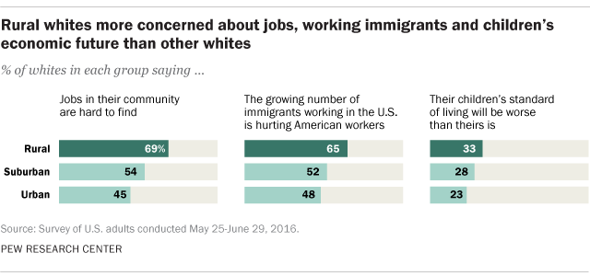

Slide 47
Cultural gaps
Rural America has long been the butt of condescending jokes repeated by urban folks:
“Flyover country” (except when we visit a national park)
“Pennsylvania is Philadelphia and Pittsburg separated by Alabama.”
“I didn’t just fall off a turnip truck.”
Rural people are yokels, rubes, hicks, rednecks, hillbillies.
“The Beverly Hillbillies” -- hit TV show from 1962 to 1971 about a newly oil-rich family of rural innocents moving to Hollywood
“Lil’ Abner” – popular comic strip from 1934 to 1977 about fictional clan of hillbillies in impoverished rural “Dogpatch”

Slide 48
Will rural still be left behind?
Will urban liberals simply say “rural is hopeless, not worth the effort?”
Will left-leaning Democrats be unwilling to support policies that appeal to potential rural supporters?
Will progressives say rural and all Trump supporters deserve Trump’s program cuts?
Is “basket of deplorables” unfortunately a true description of some?
Tom Perez, former Secretary of Labor and Democratic party chair, says of his party’s 2016 failures, “We didn’t make house calls.” Is this a condescending statement?

Slide 49
One opinion
“I hate these people. Truly the worst of humanity. To hell with every one of them.”
-- A reader’s tweet to NYT columnist Nicholas Kristoff, 6 April 2017, after his prior appeal to “be nice to Trump voters.”

Slide 50
Marc Hetherington & Jonathan Weiler, Prius or Pickup: How the Answers to Four Simple Questions Explain America’s Great Divide (New York: Houghton Mifflin Harcourt, 2018)
“I am going to read you pairs of desirable qualities for children. Please tell me which one you think is more important for a child to have.
1. Independence versus respect for elders
2. Obedience versus self-reliance
3. Curiosity versus good manners
4. Being considerate versus being well-behaved”
Those picking respect for elders, obedience, manners, & well-behaved were more likely to be Trump voters. Those picking the other 4 were likely to be Clinton voters.

